Slide 1
Encryption program

Slide 2
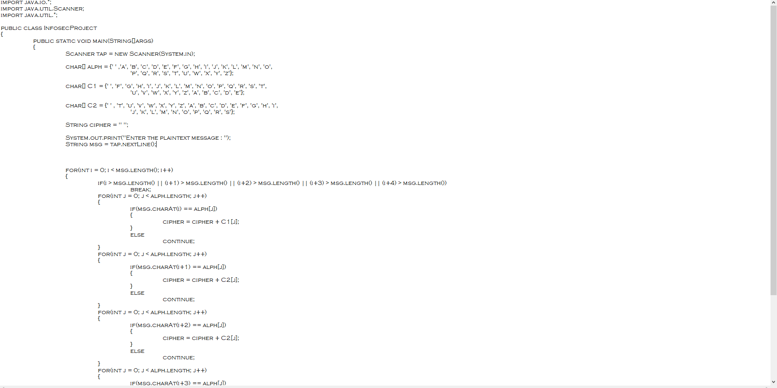

Slide 3


Slide 4


Slide 5
Decryption program

Slide 6
